Slide 1
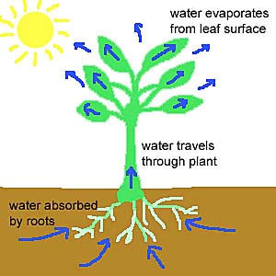
Transpiration

Slide 2
Evaporation of water from the plant leaves
- pulls the water up from the roots
- cools the plant

Slide 3
How it Works
Water and minerals move in through the roots, up the xylem, into the leaves
The water is warmed by the sun, turned into a gas (vapor), and passes out the stomata
The guard cells regulate how much water leaves the plant
When the water reaches the guard cells, they swell and stretch, opening the stomata
As water goes out, the guard cells relax and the stomata close

Slide 4
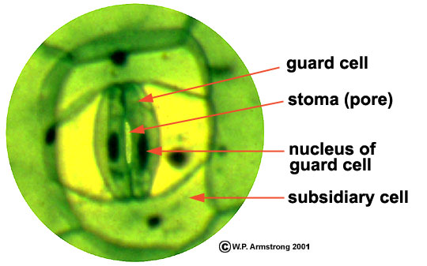
Guard Cells and stoma

Slide 5
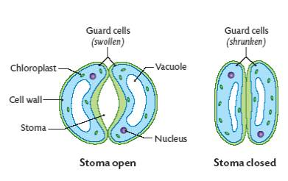
Stoma open and closed

