Slide 1
Plant Life and Ecosystems
End of Year Review

Slide 2
What are the standards?
6. L. 1. Understand the structures, processes and behaviors of plants that enable them to survive and reproduce.
6.L.2. Understand the flow of energy through ecosystems and the responses of populations to the biotic and abiotic factors in their environment.

Slide 3
6. L. 1. Understand the structures, processes and behaviors of plants that enable them to survive and reproduce.

Slide 4
What are YOU expected to know about plants?
Animals and plants have a great variety of body plans and internal structures that contribute to their being able to make or find food and reproduce.
The process of sexual reproduction in flowering plants takes place in the flower, which is a complex structure made up of several parts.
Some parts of the flower are directly involved in fertilization and seed production. Other flower parts have functions in pollination.
A flower is made up of six parts

Slide 5
Animals and PLANTS have a great variety of body plans and internal structures that contribute to their being able to make or find food and reproduce.
Why do plants have flowers?
The purpose of flowers is to help the plant reproduce through pollination and fertilization.
How do plants make food?
Photosynthesis is the process where water and carbon dioxide are turned into glucose, which the plants use for food.
Where does photosynthesis happen?
In the chloroplasts of the green leaves on a plant are where photosynthesis takes place.

Slide 6
Animals and PLANTS have a great variety of body plans and internal structures that contribute to their being able to make or find food and reproduce.
When fertilization happens, the ovules in the flower will turn into seeds. The flower then will either
Turn into a fruit where the ovary meets the stem. The fruit that surrounds the seeds smells sweet, which attracts consumers. This fruit will eventually be eaten by a consumer which will deposit the seeds in it’s excrement at a location far away from the original plant.
Why? Because plants need to reproduce, but do not want to compete for resources such as light or water with offspring. By housing the seeds in something consumers need to eat for energy (like an apple), the plant can make sure the next generation of plant will survive without competing with the primary plant.

Slide 7
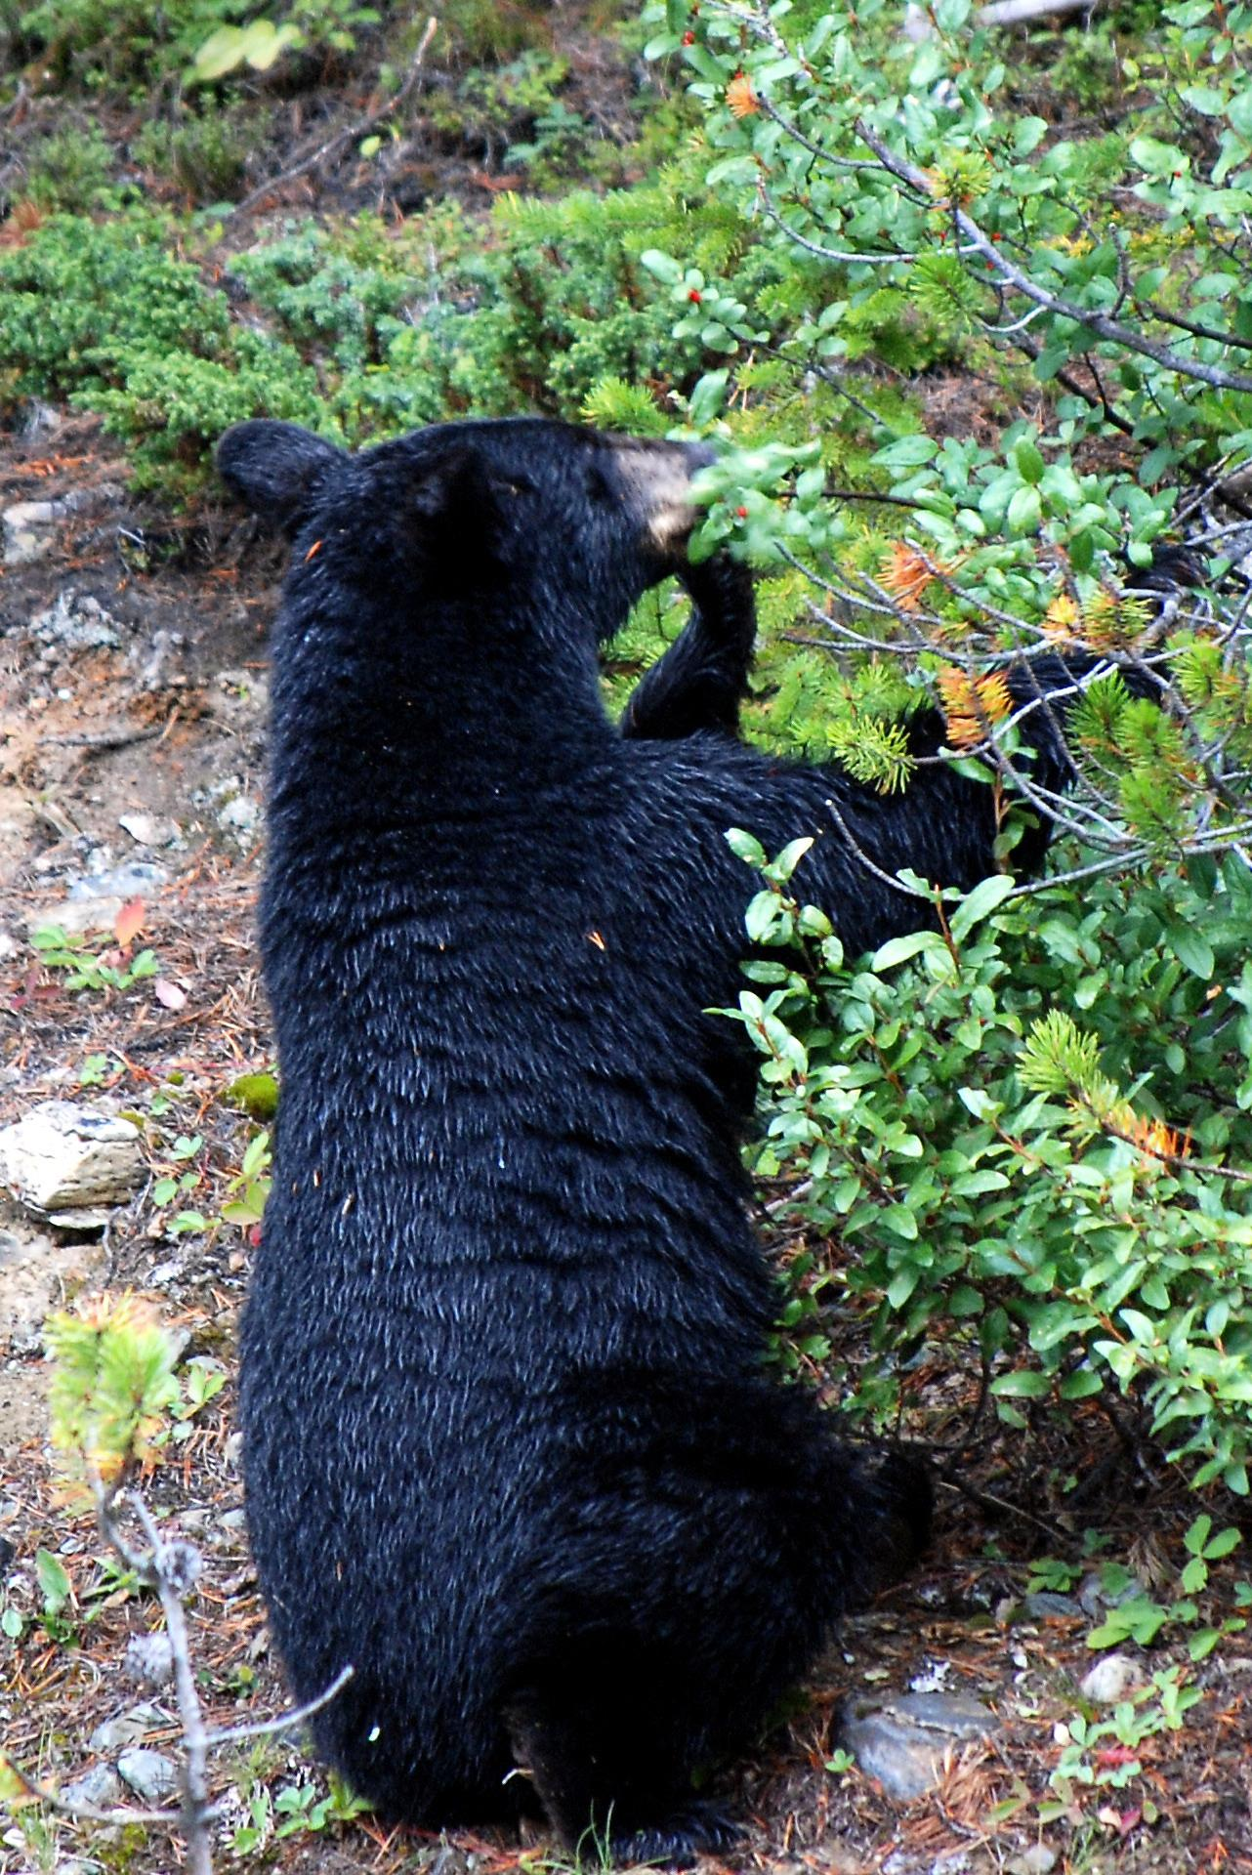
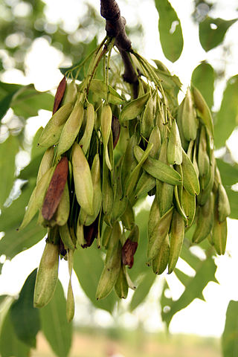
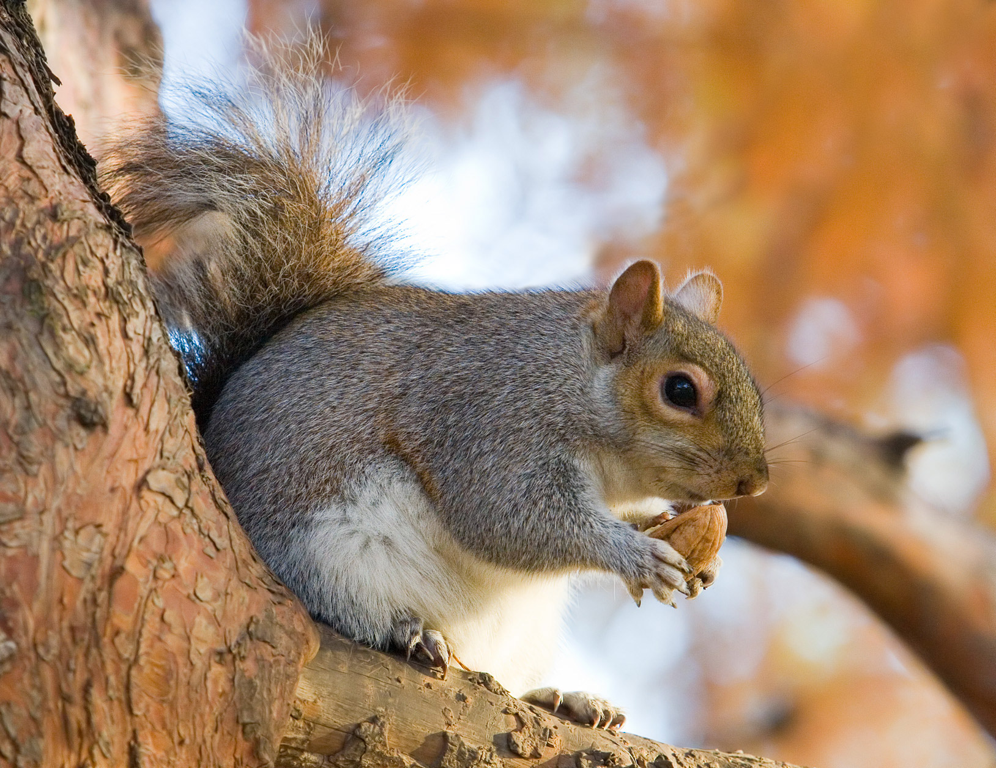
Animals and PLANTS have a great variety of body plans and internal structures that contribute to their being able to make or find food and reproduce.
2) Ovules turn into seeds which drop off of the plant and use a variety of methods to travel away from the plant.
Some consumers, like this squirrel, take the seed (acorn) and bury it far away from the Oak tree where it fell. Any acorns the squirrel doesn’t eat during winter may turn into an Oak tree sapling in the Spring! | Some plants have ovaries that grow into fruit around the ovules. Consumers eat the fruit, excreting the seeds in their feces, away from the original plant. | Some plants have seeds that are shaped like propellers. They are carried off by the wind, far away from the original tree.

Slide 8
The process of sexual reproduction in flowering plants takes place in the flower, which is a complex structure made up of several parts.
Some parts of the flower are directly involved in fertilization and seed production. Other flower parts have functions in pollination.
There are two types of flowering plants, perfect and imperfect.

Slide 9
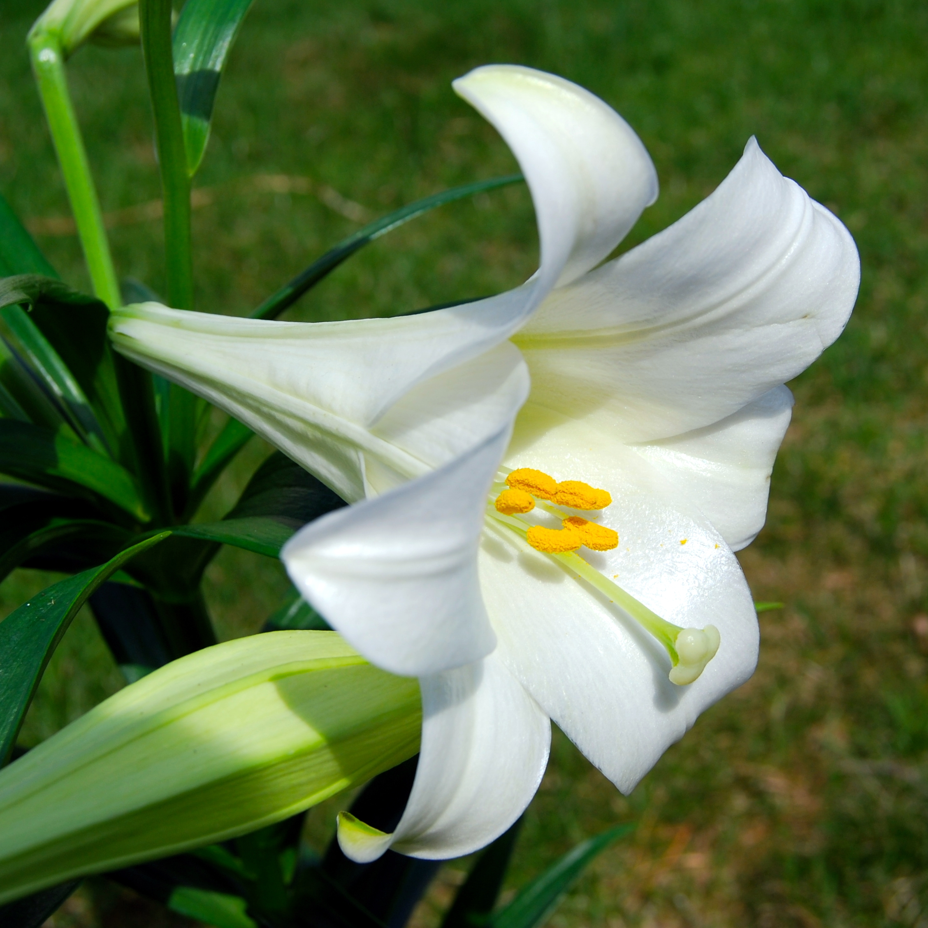
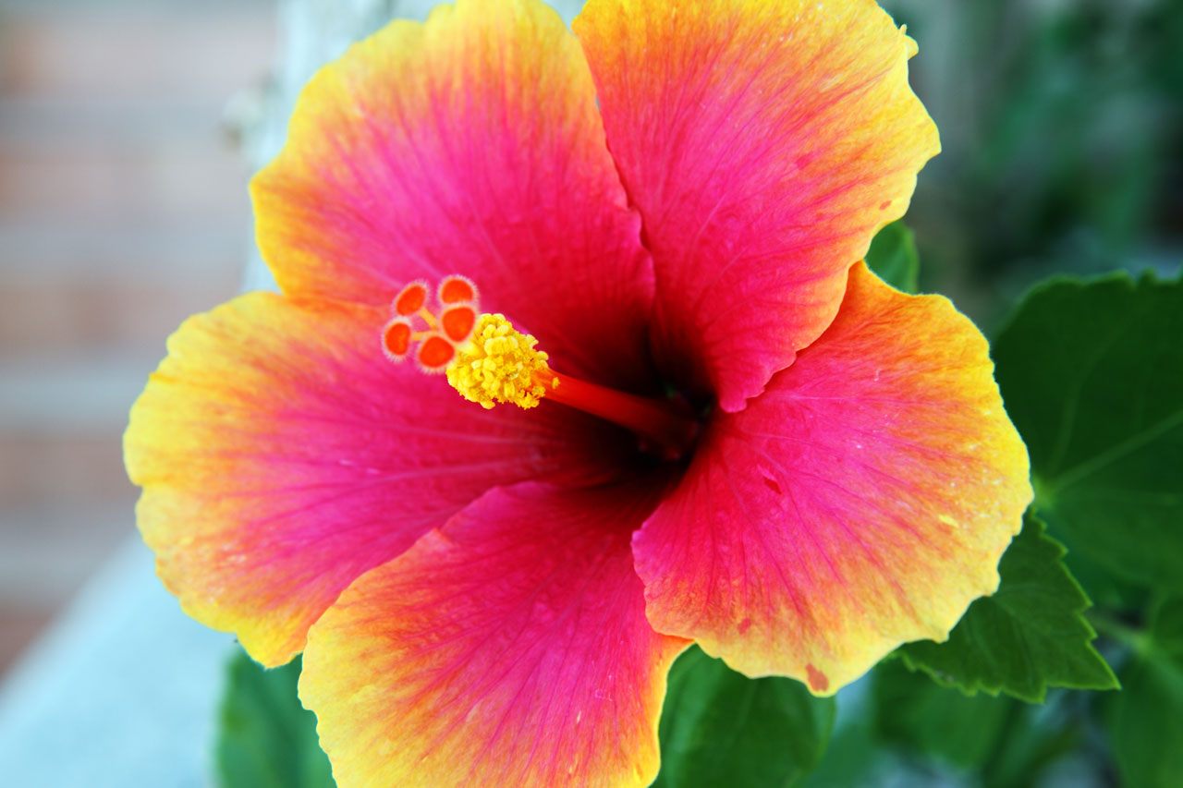
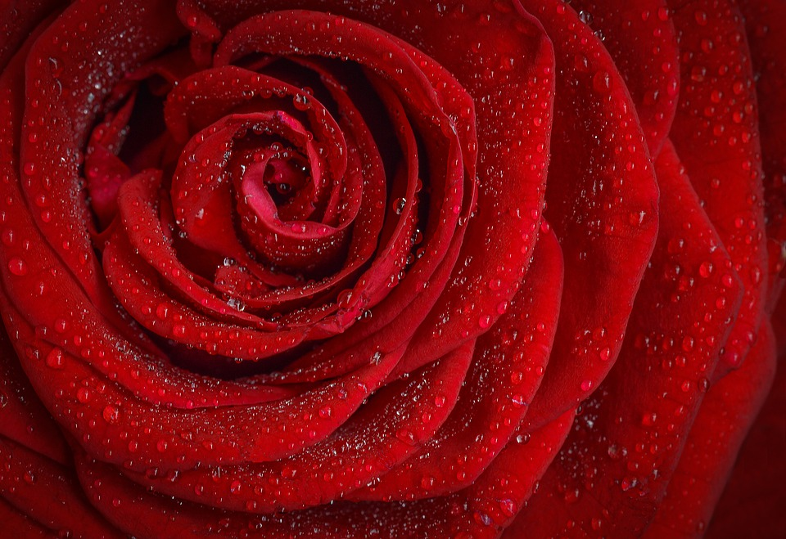
Two types of Flowering plants
Perfect: Contains both male and female parts
Examples:
Roses
Lilies
Hibiscus

Slide 10
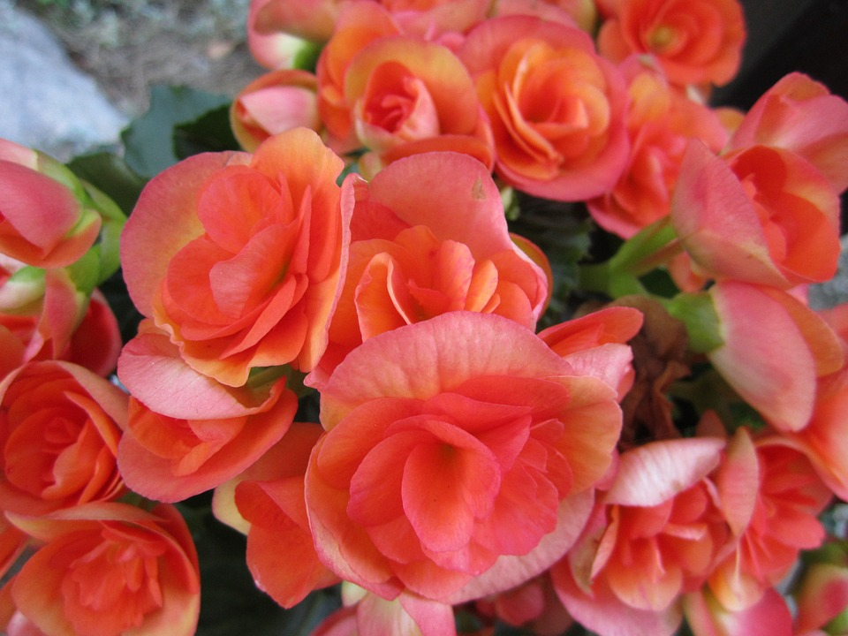
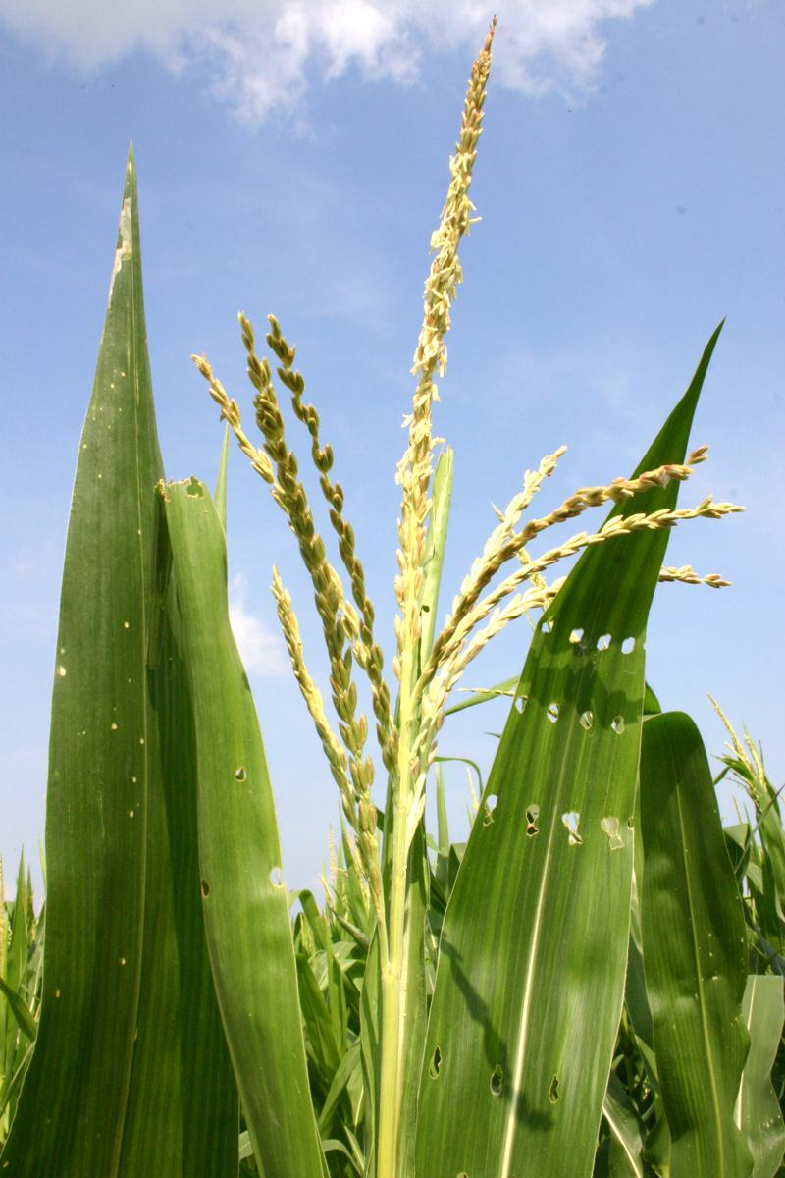
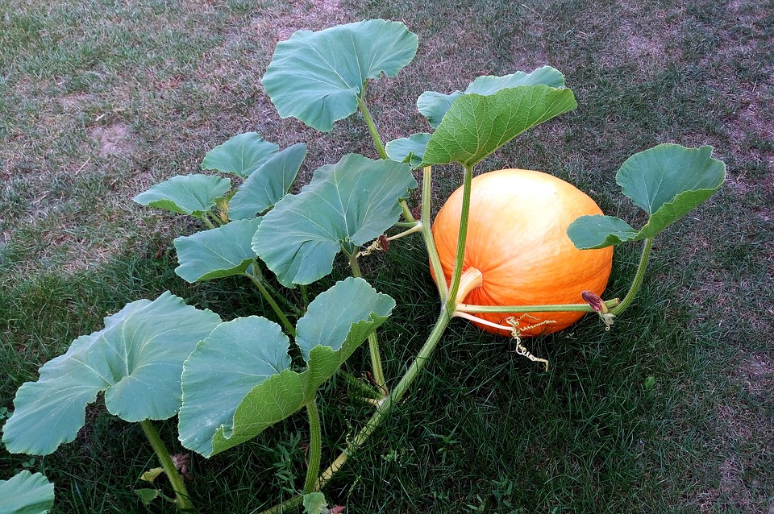
Two types of Flowering Plants
Imperfect: contains either male or female parts (not both!)
Examples:
Begonias
Corn
Pumpkin

Slide 11
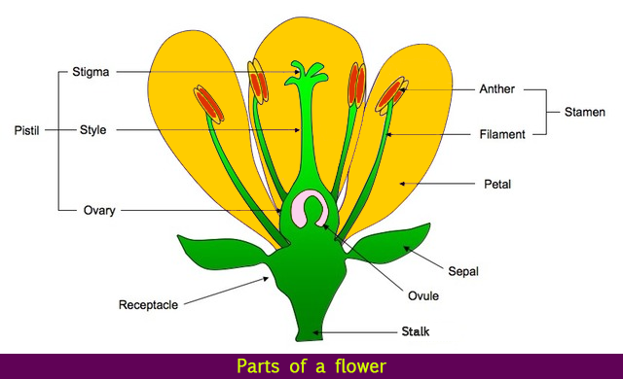
Plant Structure and Function: Parts of the Flower
A flower has six parts.
Female part of Flower
Male part of flower

Slide 12
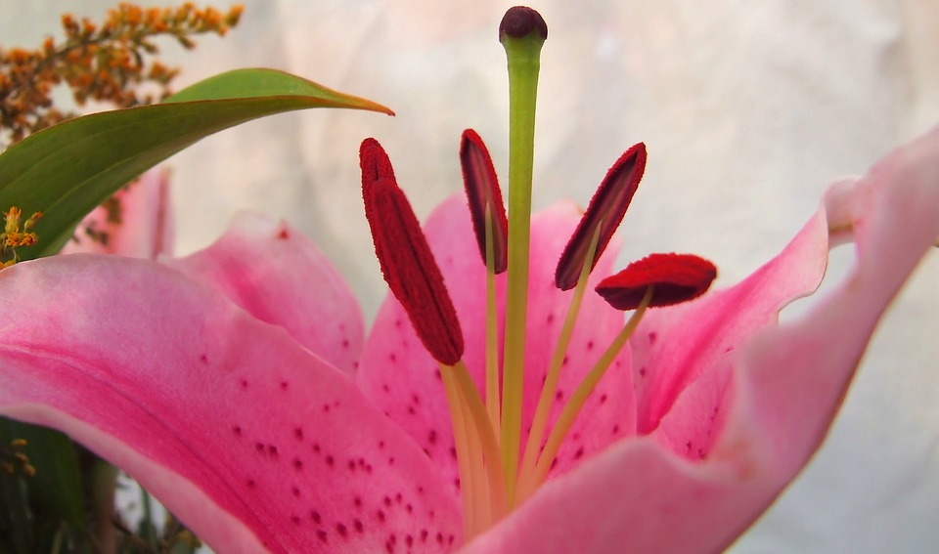
Female parts of Flower
The female reproductive structure is made of three parts: Stigma & Style (both start with s— females have style) and Ovary
Stigma: sticky surface on top of the pistil that traps and collects pollen.
Style: tube that holds up the stigma
And provides a path for pollen to get
From the stigma to the ovary.
Stigma
Style

Slide 13
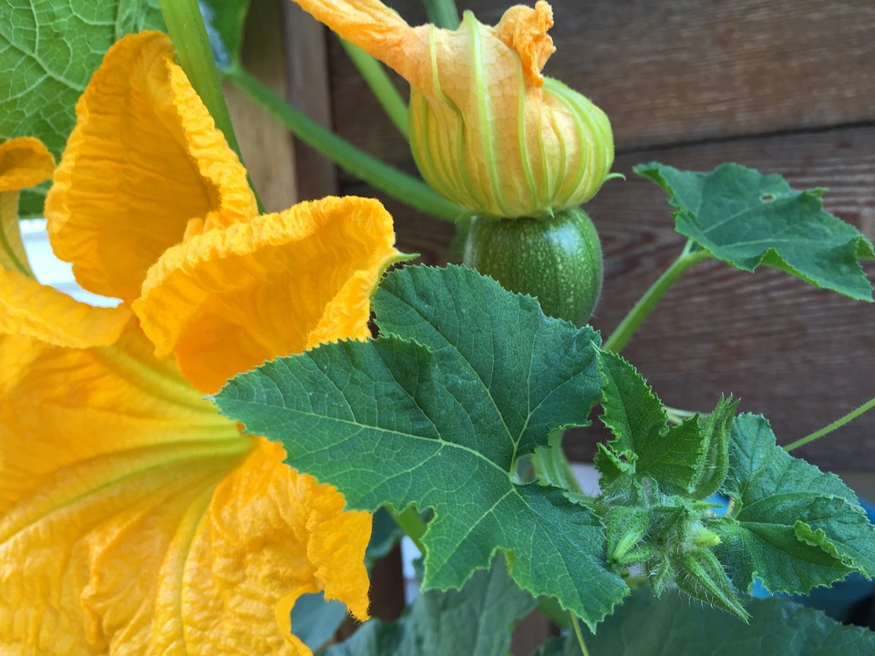
Female Parts: The Ovary
At the bottom of the style is the ovary
When fertilized, ovary becomes the fruit
Female sex cells (ovules) stored in the ovary
Ovules turn into seeds when pollen and ovule meet
This is a picture of a squash plant where the flower has been fertilized and the ovary is now turning into the fruit (in this case, a squash!)

Slide 14
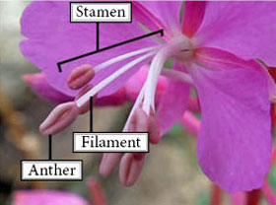
Male Parts of Flower
The male reproductive structure is made of two parts: Anther & Filament
Anther: top part of the stamen that makes and stores the pollen
Filament: thread-like stalk that holds up the anther
Pollen:Male sex cell stored on the anther
Powdery substance typically yellow or orange

Slide 15
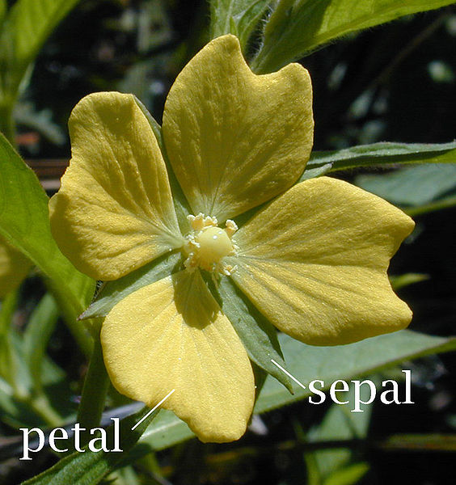
Parts of Flower
Petals: Colorful layers that surround the reproductive parts and attract pollinators to flower
Sepals: Green petal-like part at the base of the flower which protect the bud

Slide 16
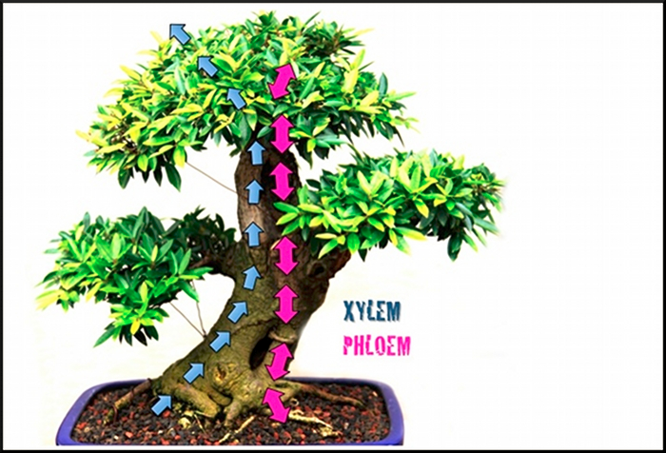
Xylem and Phloem
Vascular parts of the stem and plant
Xylem carries water and nutrients up
from ground, through roots and to leaves
Phloem carries glucose made during
photosynthesis down from leaves to the
rest of the plant

Slide 17
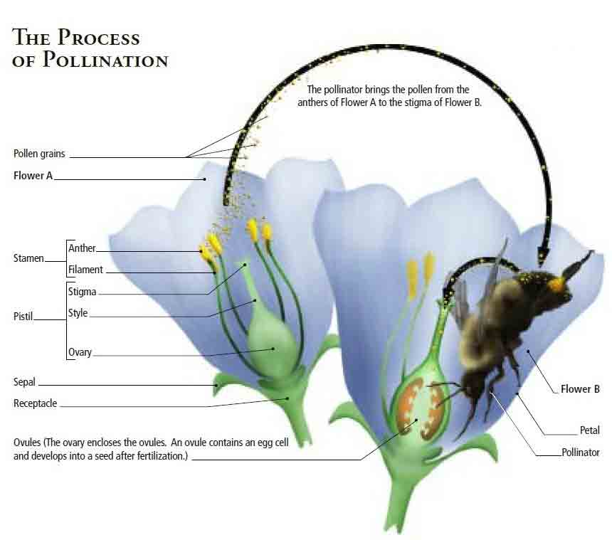
The process of sexual reproduction in flowering plants takes place in the flower, which is a complex structure made up of several parts.
Pollination

Slide 18
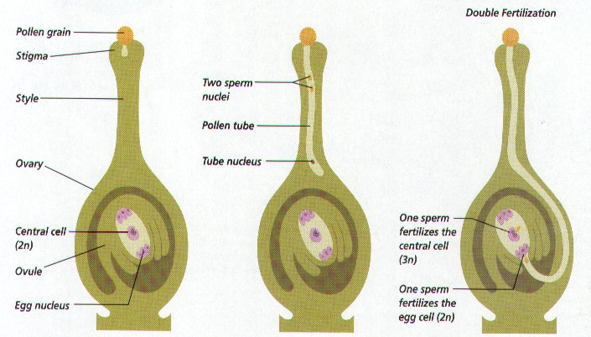
The process of sexual reproduction in flowering plants takes place in the flower, which is a complex structure made up of several parts.
Fertilization
pollen
Pollen has traveled down the tubule and fertilizes the ovules

Slide 19
Photosynthesis
Photosynthesis is the process by which plants produce their food in the presence of sunlight, water, and carbon dioxide.

Slide 20
What happens during Photosynthesis?
Plants use light energy from the Sun to convert carbon dioxide and water into sugar(glucose)
Oxygen is made as a byproduct during photosynthesis

Slide 21
WHO carries out Photosynthesis?
Plants, algae, and many single-celled organisms (bacteria) arry out photosynthesis

Slide 22
What powers photosynthesis?
THE SUN!!!!!
Photosynthesis is the connection between energy that is released from the sun (solar energy) and the energy available for living organisms (chemical energy).

Slide 23
Materials Used In Photosynthesis
Carbon dioxide gas, sunlight and water are used during photosynthesis

Slide 24
How do plants get carbon dioxide?
Plants get carbon dioxide from the atmosphere. The carbon dioxide is absorbed through stomata.
Stomata are tiny holes or pores found in the leaves of plants.

Slide 25
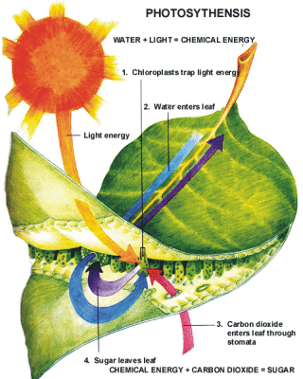
SOME FUNCTIONS OF THE STOMATA
Stomata help the leaves by absorbing carbon dioxide from the air.
Stomata also allow oxygen produced during photosynthesis to escape into the atmosphere.

Slide 26
What is the equation for the chemical reaction of photosynthesis?

Slide 27
Materials Produced During Photosynthesis:
During photosynthesis, water and carbon dioxide from the environment are combined to make an organic compound, called glucose. Glucose is a simple carbohydrate or a simple sugar.
Oxygen gas is also formed during photosynthesis. The oxygen that is produced is released into the environment.
Photosynthesis occurs in plant cells (in the chloroplasts) when light is available. Generally this is during the day time.

Slide 28
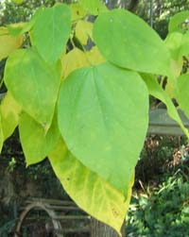
WHERE does Photosynthesis occur?
Photosynthesis occurs in the chloroplasts of plant cells when they are exposed to light

Slide 29
WHY is Photosynthesis important?
Photosynthesis helps plants produce their own food
Plants are the first step in the food chain. We cannot make our own food (glucose, energy), we must get our food from plants.
The oxygen released during photosynthesis is necessary for all living things.

Slide 30
What is Cellular Respiration?
The release of chemical energy for use by cells.
Once the energy that was in sunlight is changed into chemical energy by photosynthesis, an organism has to transform the chemical energy into a form that can be used by the organism.
This process is cellular respiration.

Slide 31
What is Cellular Respiration?
The breakdown of glucose molecules to release energy
Takes place in all living things
Is a step by step process

Slide 32
What is the chemical equation for cellular respiration?
C₆H₁₂O₆ + 6O₂ 6H₂O + 6CO₂ + ATP
Glucose + Oxygen Water + Carbon Dioxide + Energy

Slide 33
Relationship between Photosynthesis and Respiration
The energy stored in glucose during photosynthesis is transferred to ATP during cellular respiration.
All cells “run” on the energy released from ATP

Slide 34
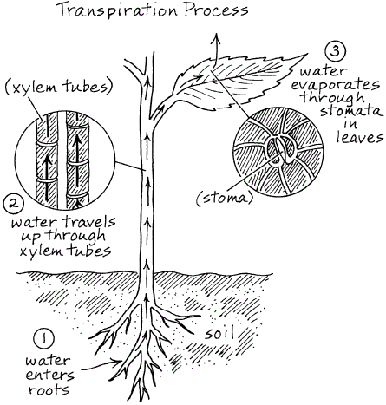
Transpiration
Keeps water moving up through roots, xylem and to leaves
Allows waste (oxygen, water vapor) to be removed and carbon dioxide to be let in
Can cool down the immediate area surrounding the plant
Stomata can close to keep the plant from losing too much water

Slide 35
Dormancy and Tropisms

Slide 36
6. L. 1. Understand the structures, processes and behaviors of plants that enable them to survive and reproduce.

Slide 37
Plant Dormancy
A period of inactivity before a plant begins to grow. The plant will start to grow when the conditions for survival are the greatest.
These conditions may include ideal temperature and soil compositions.

Slide 38
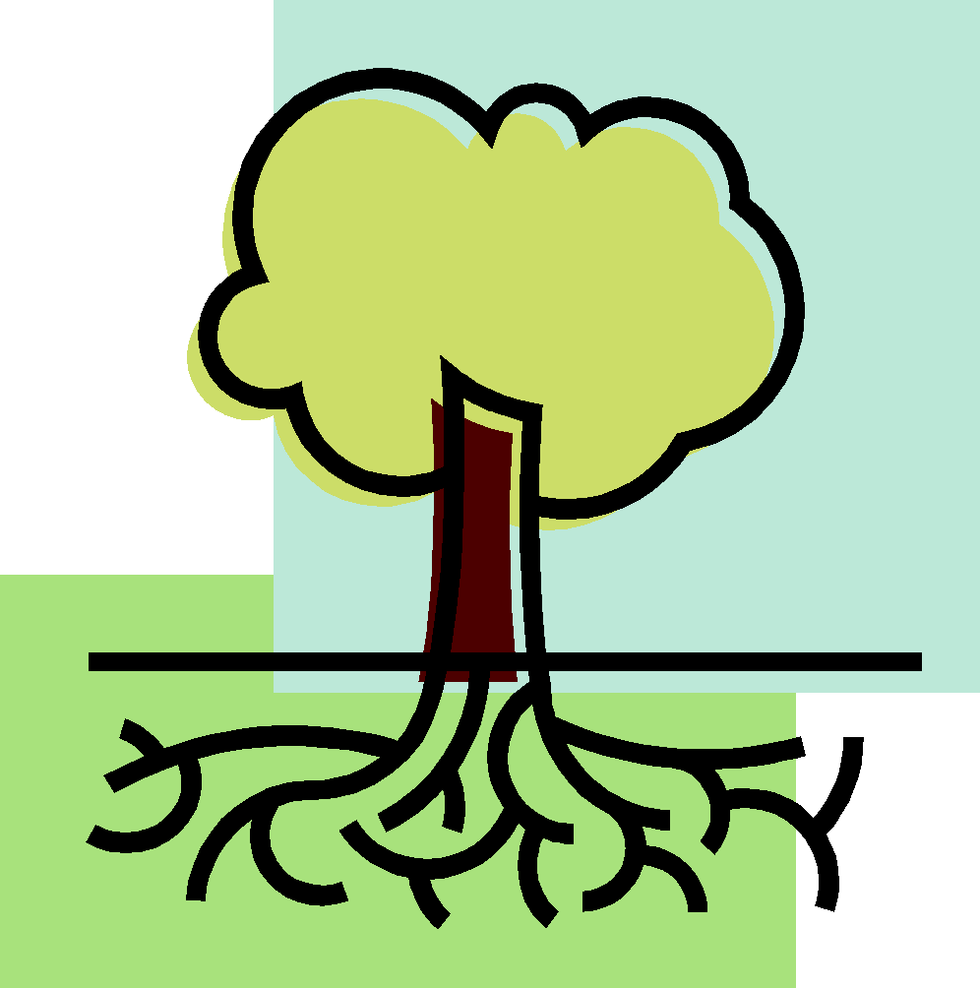
TROPISM
Plant growth in response to a stimulus
(“tropo” – ”turn”)
There are many types of tropisms :
Phototropism
Geotropism
Thigmotropism
Hydrotropism
Heliotropism
Thermotropism
Can be positive or negative

Slide 39
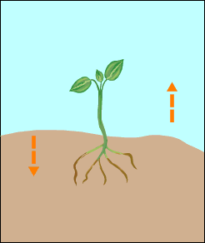
Negative Geotropism
GEOTROPISM
Geotropism is the growth of a plant in response to gravity.
Positive Geotropism
Positive Geotropism
The growth of a plant towards the center of the earth-down with gravity.
Ex. roots growing down
Negative Geotropism
The growth of a plant away from the center of the earth-opposite from the pull of gravity
Ex. stems grow up

Slide 40
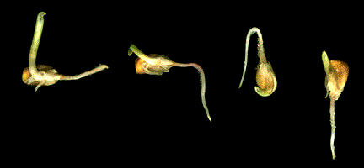
IMPORTANCE OF GEOTROPISM
Pulls roots down to anchor a plant
Roots can get needed water and
minerals if they stay in the soil

Slide 41
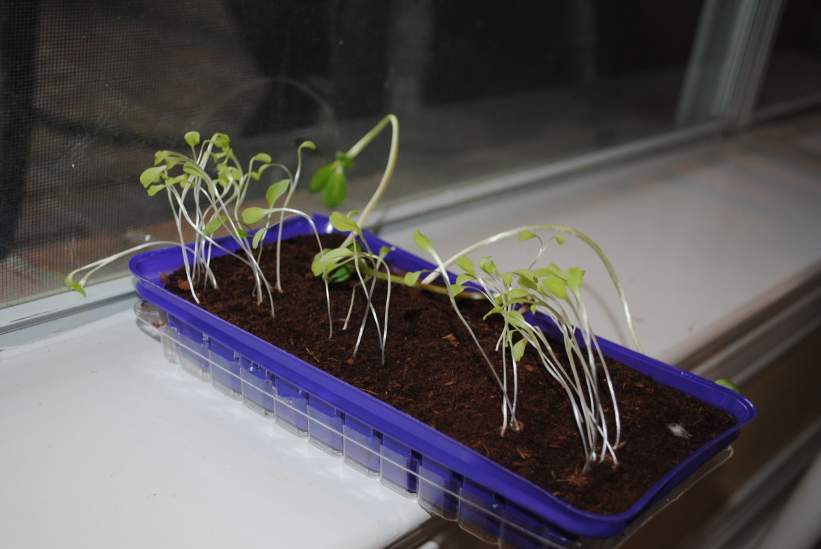
PHOTOTROPISM
(“Photo” – light)
The growth response of a plant in response to light direction is called phototropism.
Ex. Stems growing toward the window to get to the light

Slide 42
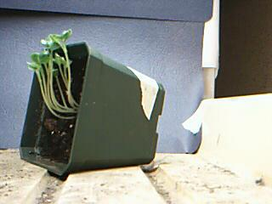
IMPORTANCE OF PHOTOTROPISM
Enables leaves to be in the best position possible to receive adequate light for photosynthesis
http://www.darienps.org/teachers/otterspoor/botany/tropisms/Gravitropismwlight.jpg

Slide 43
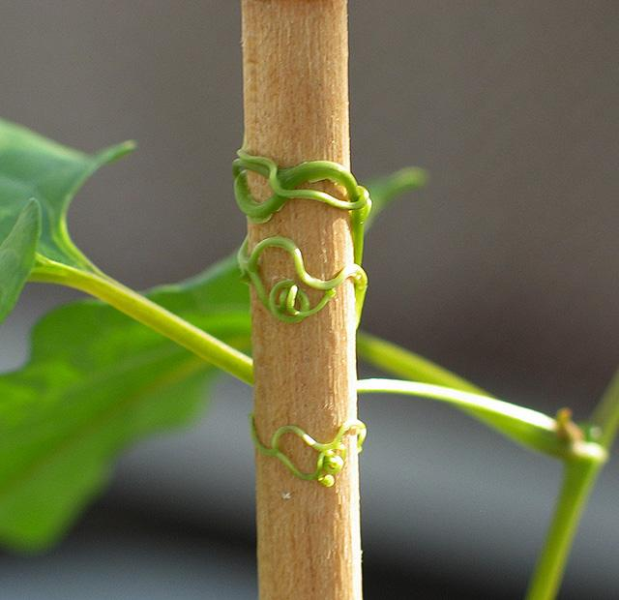
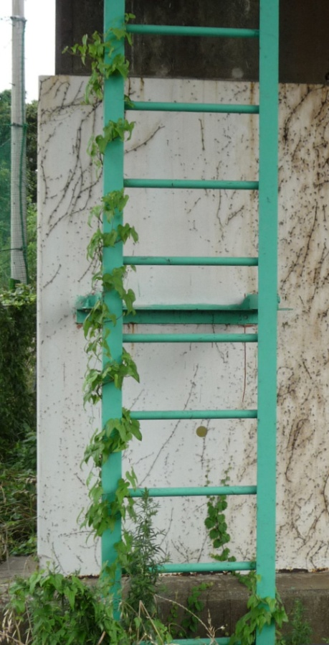
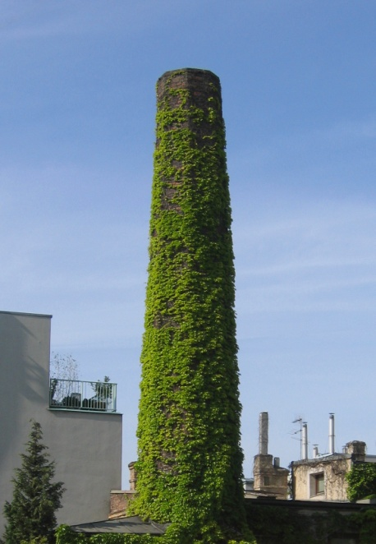
THIGMOTROPISM
(“Thigmo” – “touch”)
Thigmotropism is the growth of a plant in response to touch/contact.
Photo by Christopher Meloche
Tendrils on a sweet pea
Vines growing on a wall or fence

Slide 44
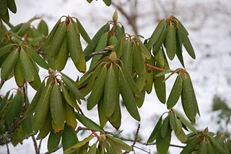
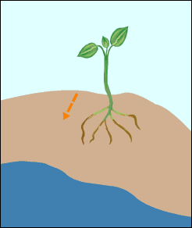
THERMOTROPISM
(“Therm” – “heat”)
Thermotropism is the tendency of plants or other organisms to bend toward or away from heat.
Ex. curling of Rhododendron leaves in response to cold temperatures.
HYDROTROPISM
(“hydro” – “water”)
Hydrotropism is the growth in response to water. Ex. roots growing toward moisture
Chemotropism
(“Chemo” – chemical”)
Chemotropism is movement caused by chemical stimuli. Ex. Growth of a pollen tube is always towards the ovules
so that reproduction can occur

Slide 45
Food Chains, Food Webs
Ecosystems

Slide 46
6.L.2. Understand the flow of energy through ecosystems and the responses of populations to the biotic and abiotic factors in their environment.

Slide 47
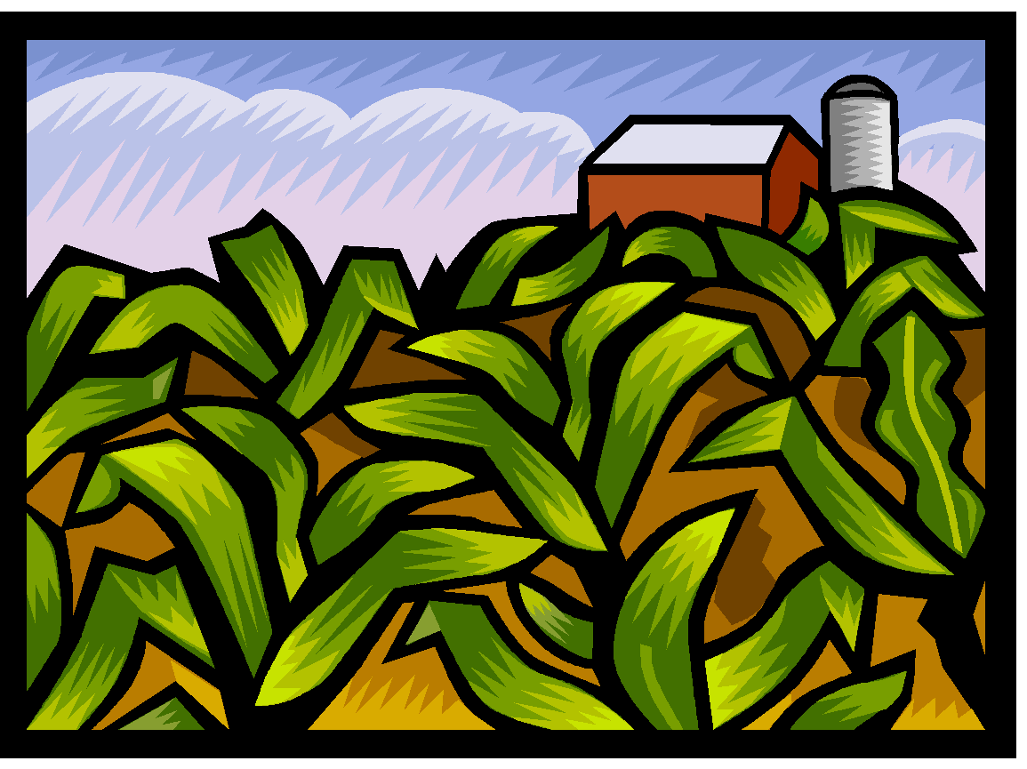
Organisms that can make glucose during photosynthesis are called PRODUCERS or Autotrophs.
Producers use most of the energy they make for themselves.

Slide 48
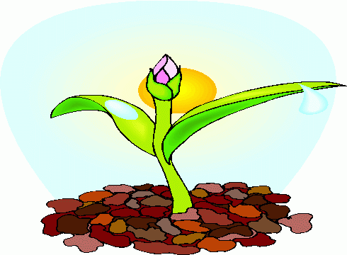
Producers use cellular respiration to supply the energy they need to live.

Slide 49
CELLULAR RESPIRATION is the chemical reaction that releases the energy in glucose.
Producers use cellular respiration to supply the energy they need to live.
6O₂ + C₆H₁₂O₆ --> 6H₂O + 6CO₂ + energy

Slide 50
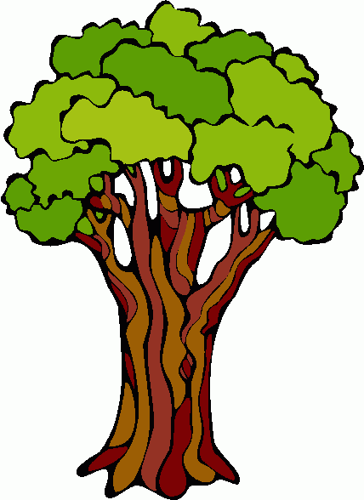
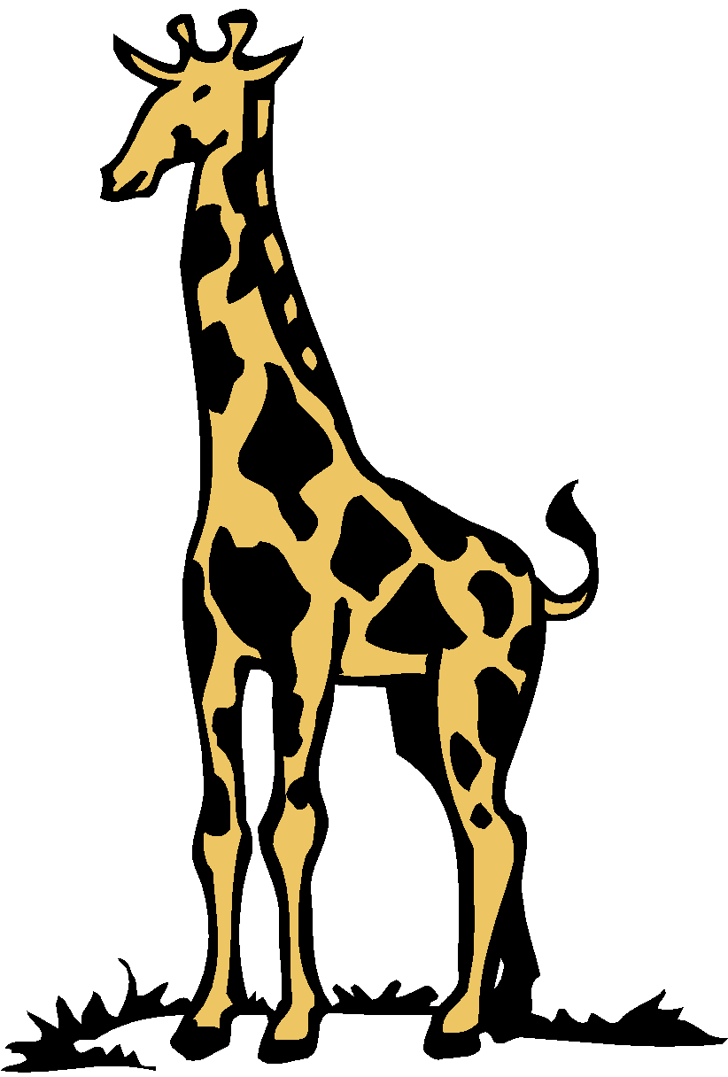
The energy that is not used by producers can be passed on to organisms that cannot make their own energy.
Organisms that cannot make their own energy are called CONSUMERS or Heterotrophs.

Slide 51
Consumers that eat producers to get energy:
Are first order or primary consumers
Are herbivores (plant-eaters) or omnivores
(plant and meat-eaters)
Most of the energy the primary consumer gets from the producer is used by the consumer.
Some of the energy moves into the atmosphere as heat.

Slide 52
Some energy in the primary consumer is not lost to the atmosphere or used by the consumer itself. This energy is available for another consumer.

Slide 53
A consumer that eats another consumer for energy:
Is called a secondary or second order consumer
May be a carnivore or a omnivore
May be a predator
May be a scavenger

Slide 54
Most of the energy the secondary consumer gets from the primary consumer is used by the secondary consumer.
Some of the energy is lost as heat, but some energy is stored and can passed on to another consumer.

Slide 55
A consumer that eats a consumer that already ate a consumer:
Is called a third order or tertiary consumer
May be a carnivore or a omnivore
May be a predator
May be a scavenger

Slide 56
Consumers that eat producers & other consumers
Are called omnivores
Omnivores eat plants and animals

Slide 57
Consumers that hunt & kill other consumers are called predators. They animals that are hunted & killed are called prey.

Slide 58
Consumers that eat other consumers that have already died are called scavengers.

Slide 59
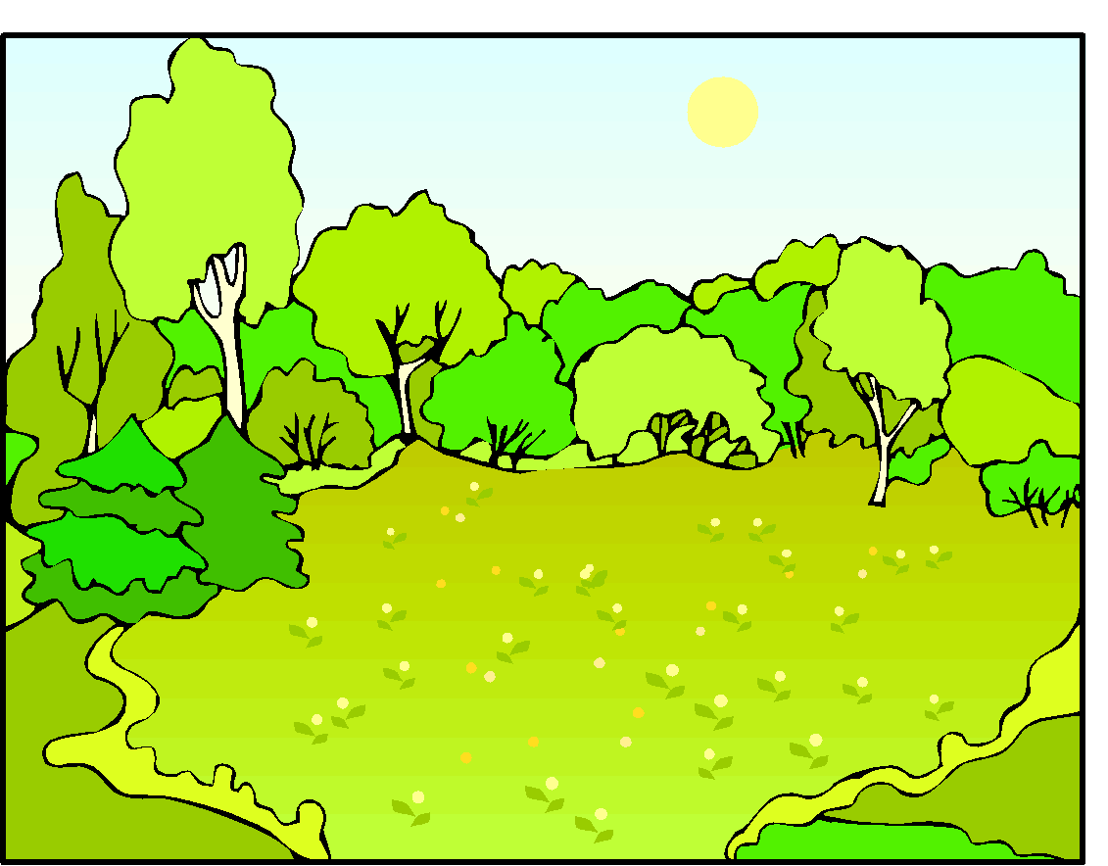
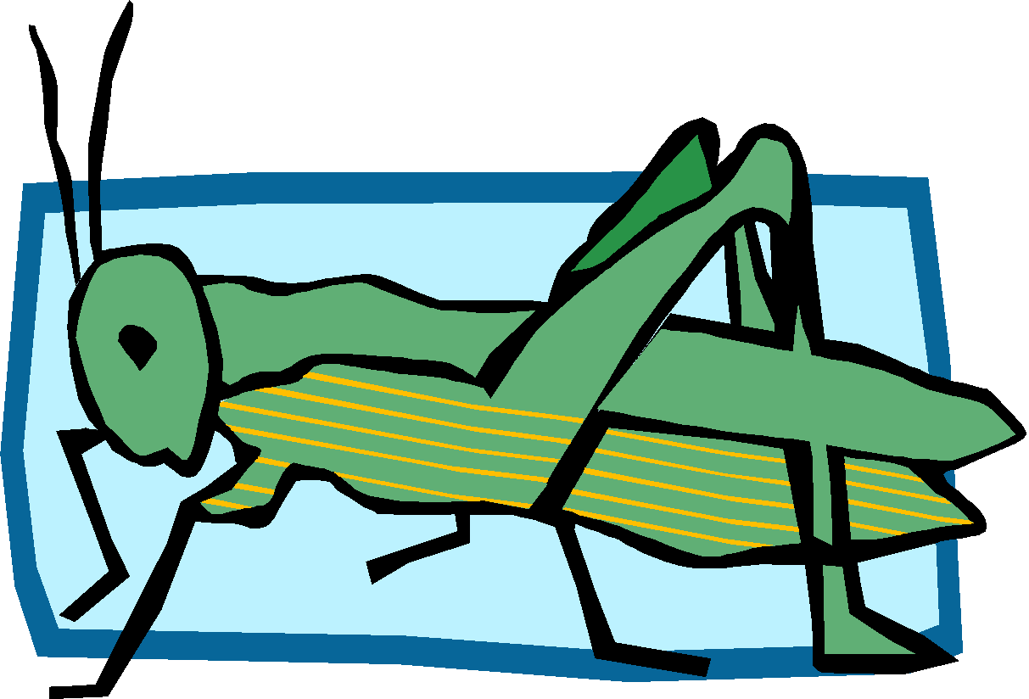
The transfer of energy from sun to producer to primary consumer to secondary consumer to tertiary consumer can be shown in a FOOD CHAIN.

Slide 60
Another way of showing the transfer of energy in an ecosystem is the ENERGY PYRAMID.

Slide 61
Energy pyramids show
That the amount of available energy decreases down the food chain
It takes a large number of producers to support a small number of primary consumers
It takes a large number of primary consumers to support a small number of secondary consumers

Slide 62
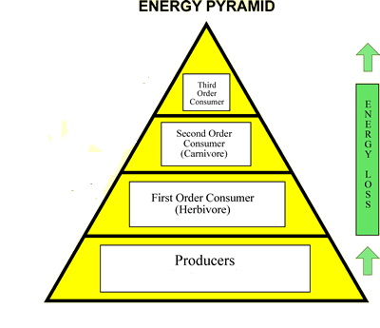

Slide 63
The 10% Rule:
Organisms will use about 90% of the energy available to them for their life processes (to live, grow, repair, reproduce) and as heat loss. Only about 10% of their energy will be available to the organism that consumes them.

Slide 64
Food Webs:
Are interconnected food chains
They show the feeding relationships in an ecosystem

Slide 65
Biomes
Ecosystems

Slide 66
6.L.2. Understand the flow of energy through ecosystems and the responses of populations to the biotic and abiotic factors in their environment.

Slide 67
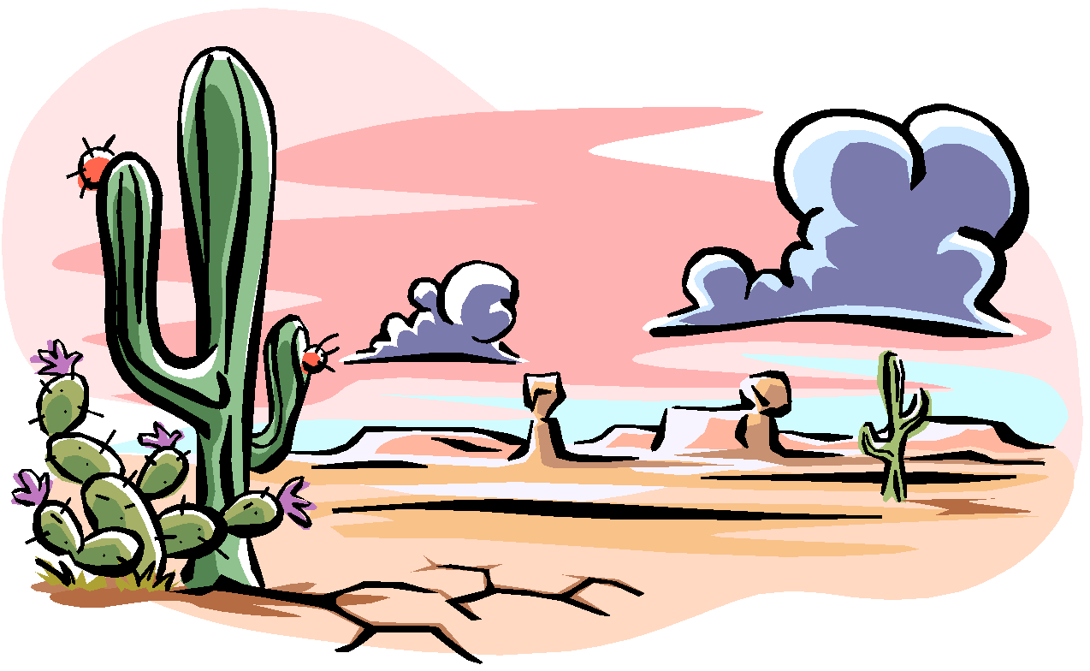
Major biomes:
Biomes are regions in the world that have their own kind of climate, soil, plants, and animals.
Taiga
Deciduous Forest
Tropical Rainforest
Desert
Tundra
Grassland
Marine
Freshwater

Slide 68
Taiga: Coniferous Forest
A cool forest biome of conifers in the upper Northern Hemisphere.
Also called the boreal forest
The largest terrestrial biome
Temperatures are low
Precipitation is primarily snow
Soil is nutrient poor and acidic
Flora is mostly conifers
Animals include woodpeckers, hawks, moose, bear and lynx.

Slide 69
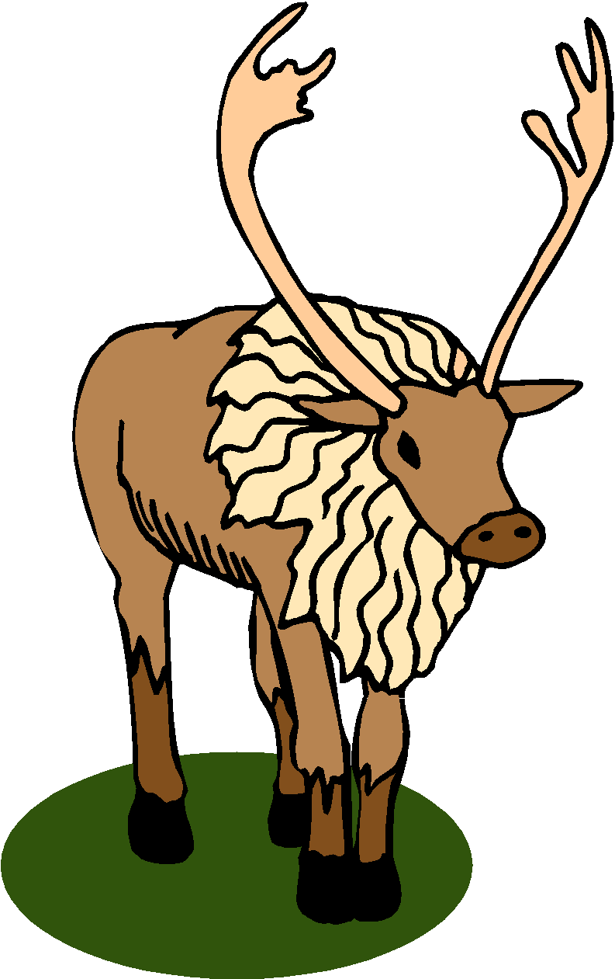
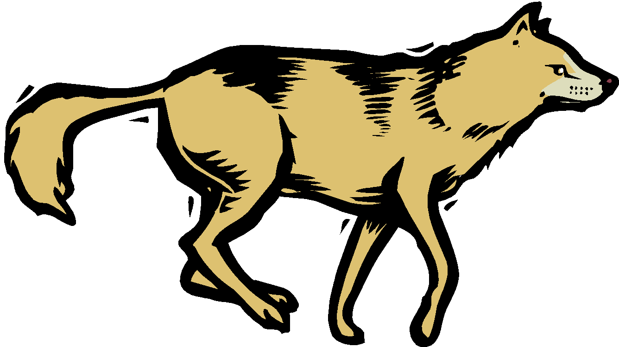
Animals of the Taiga
Rodents, snowshoe hares, lynx, sables, ermine, caribou, bears, wolves, birds in summer

Slide 70
Taiga Plant Adaptations
Mostly evergreen trees
Very shallow root systems due to permafrost
Narrow and waxy-coated conifer needles help prevent evaporation of water during winter months
Conifer needles live for many years
Poisonous oils in needles make soil acidic so don’t have lots of competition from other plants

Slide 71
Deciduous Forest
A forest biome with many kinds of trees that lose their leaves every year during fall.

Slide 72
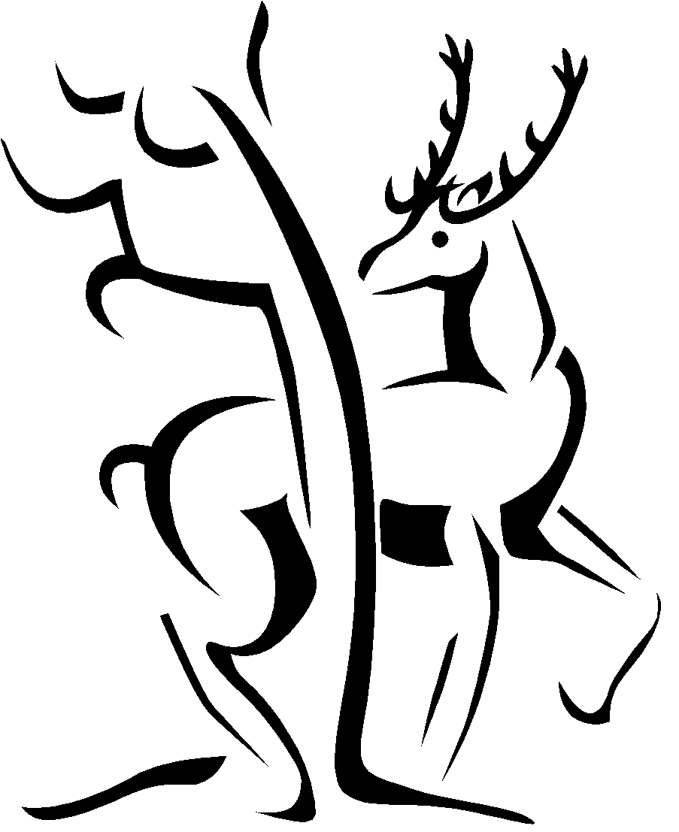
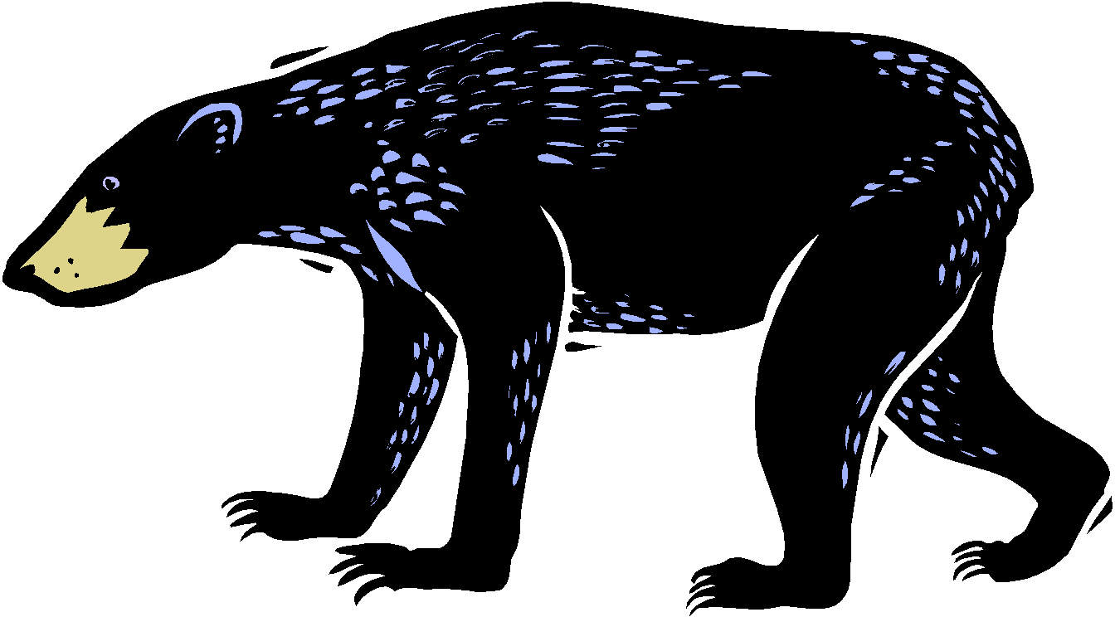
Animals of the Deciduous Forest
Wolves, deer, bears, and a wide variety of small mammals, birds, amphibians, reptiles, and insects.

Slide 73
Deciduous Forest Plant Adaptations
Plants grow in stages (first forest floor, then shrubs, then tree leaves) to avoid having to compete as much for sunlight
Trees shed leaves to reduce water loss
Thick bark protects from cold in winter

Slide 74
Tropical Rain Forest
A hot, humid biome near the equator, with much rainfall and a wide variety of life.
Lots of rain
Little variation in climate
Highly diverse species
Soil is nutrient-poor and acidic

Slide 75
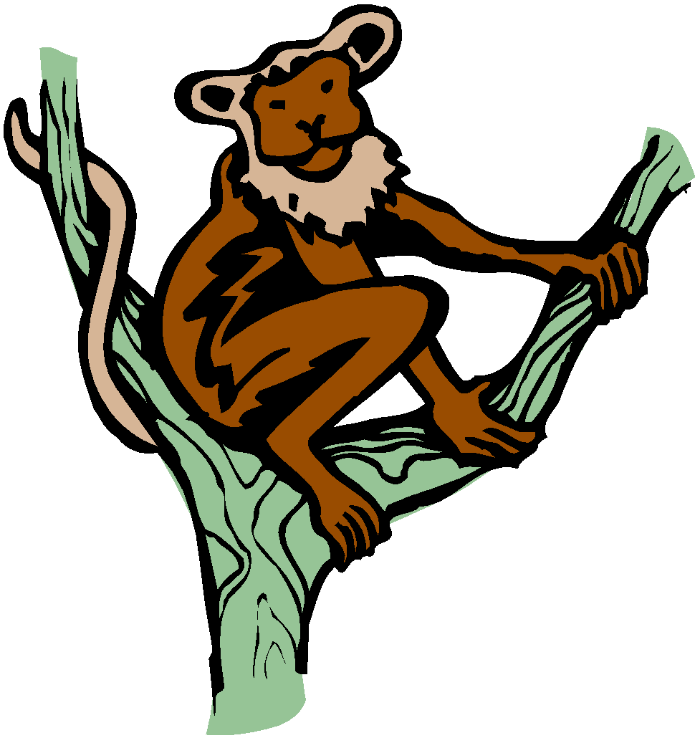
Animals of the Tropical RainForest
More species of insects, different types of colorful birds, reptiles, amphibians, and mammals are found here as compared to any other place.

Slide 76
Rainforest Plant Adaptations
Many trees have drip tips that let water run off leaves faster
Epiphytes (plants that grow without soil)grow on tree branches & they absorb water and nutrients directly from the air & from rainwater or condensation
Bromeliads have leaves that grow in spiral to channel water to center as a water tank for the plant
Orchids have fungus that grows into their roots to help absorb & deliver water to the orchid

Slide 77
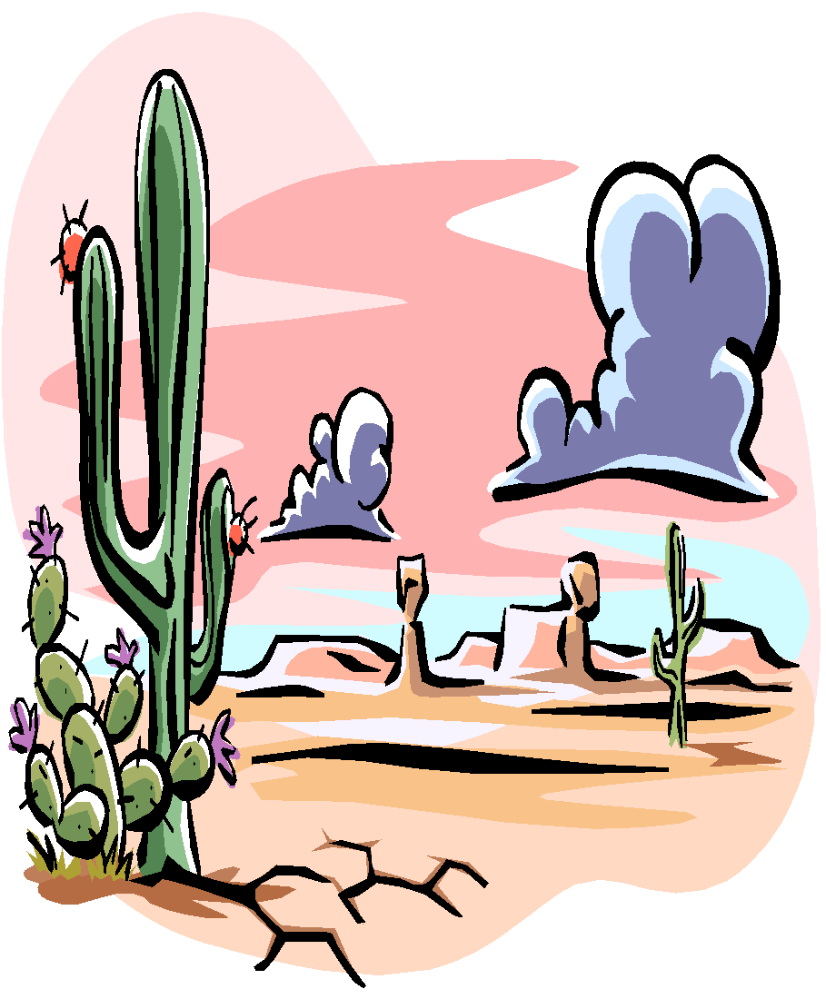
Desert
A sandy or rocky biome, with little precipitation and little plant life.
Animals are small
Many animals are nocturnal
Temperatures can be very hot or very cold
Plants are adapted to conserve water

Slide 78
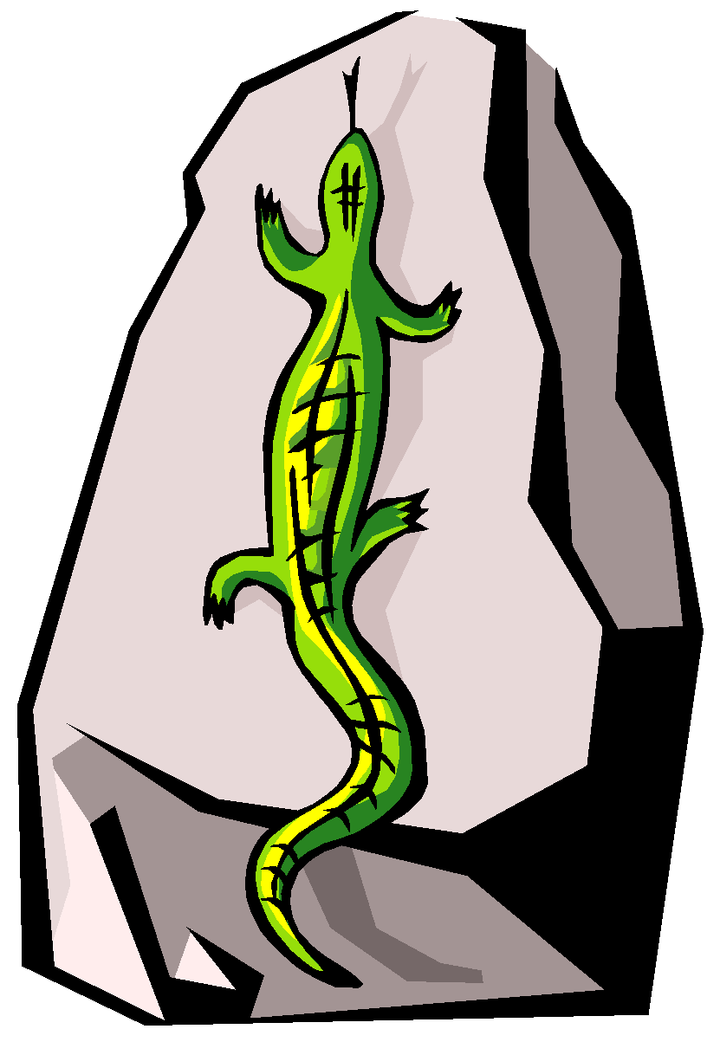
Animals of the Desert
Rodents, snakes, lizards, tortoises, insects, and some birds. The Sahara Desert in Africa is home to camels, gazelles, antelopes, small foxes, snakes, lizards, and gerbils.

Slide 79
Plant Adaptations in Desert
Structures to reduce evaporation (very small leaves or spines, thick, waxy skin)
Store water (succulents)
Shield plant surface from sun (hairy leaves)

Slide 80
Tundra
A cold biome of the far north; the ground is frozen even in summer
Very cold
Low diversity
Simple vegetation
Short growing season

Slide 81
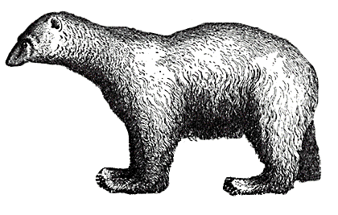
Animals of the Tundra
Musk oxen, migrating caribou, arctic foxes, weasels, snowshoe hares, owls, hawks, various rodents, occasional polar bear.

Slide 82
Plant Adaptations in Tundra
Cup-shaped flowers that focus and hold warmth of sun
Some have flowers that track the sun
Most have hairy stems for warmth
Small leaves, close to ground, underground stems, waxy surface
Grow in clumps (lichens and mosses) for warmth

Slide 83
Grassland
A biome where grasses, not trees, are the main plant life. There are two types of grasslands: Tropical grasslands (Savannah) and the Temperate grasslands.
Dominated by grass
Savannah has a wet and dry season
Temperate grassland has hot summers and cold winters

Slide 84
Grassland animals
American Grasslands (Prairies): Prairie dogs, foxes, small mammals, snakes, insects, various birds.

Slide 85
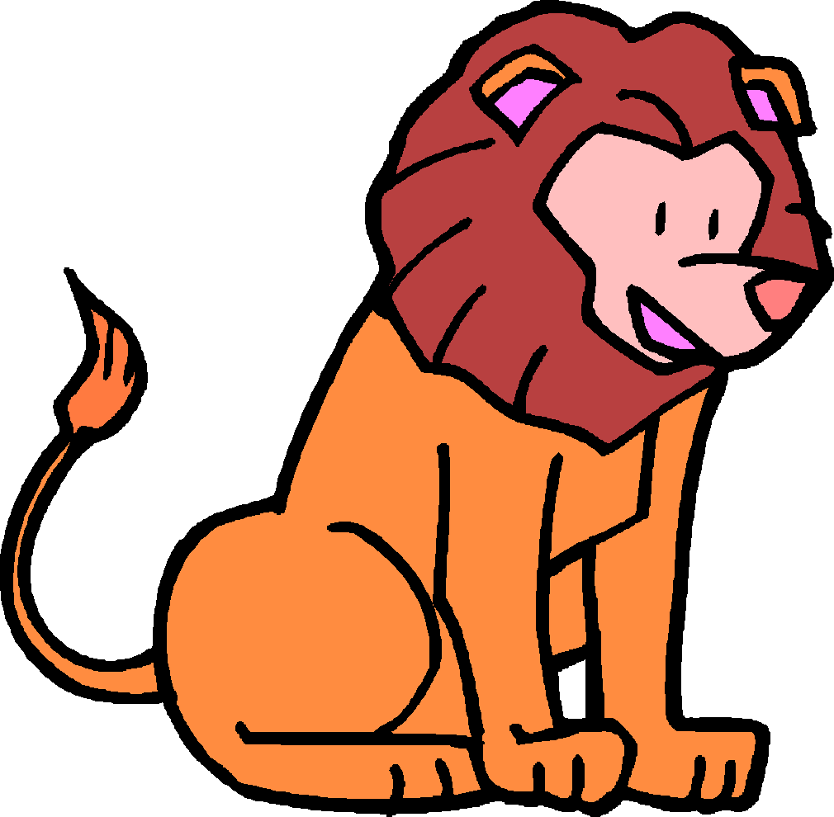
Grassland animals
African Grasslands (Savannah): Elephants, lions, zebras, giraffes.

Slide 86
Grassland Plant Adaptations
Grasses have underground roots that can store moisture
Trees usually have very deep roots and some can store water in trunks
Grasses can grow from seed but also from rhizomes(underground stems)
Blades of grass & shrub leaves have narrow leaves to lose less water and limit surface area exposed to sun

Slide 87
Marine Biome
Consists of oceans, coral reefs, and estuaries
The ocean is the largest of all ecosystems.
The ocean contains a diverse array of plants and animals at various depth zones.
Coral reefs consist mainly of coral.
Estuaries are areas where fresh and salt water environments converge. Mangroves, oysters, crabs and marsh grasses are examples of species in this environment.

Slide 88
Freshwater Biomes
Includes ponds, and lakes; streams and rivers, and wetlands.
Ponds and lakes have well lit zones and a variety of fish dominate this zone.
Streams and rivers move in one direction.
Wetlands are areas of standing water that support aquatic plants.

