Slide 1
Eclipses

Slide 2
Eclipses
Eclipses happens when either the moon’s shadow hits Earth or when the Earth’s shadow hits the moon.
When an object in space comes between the sun and another object, the first object causes a shadow on the second object, causing an eclipse.

Slide 3
2 Types
Solar Eclipse – when the moon passes between the sun and Earth, blocking the sunlight from Earth
Lunar Eclipse – when the Earth passes between the moon and the sun, blocking the sunlight from the moon

Slide 4
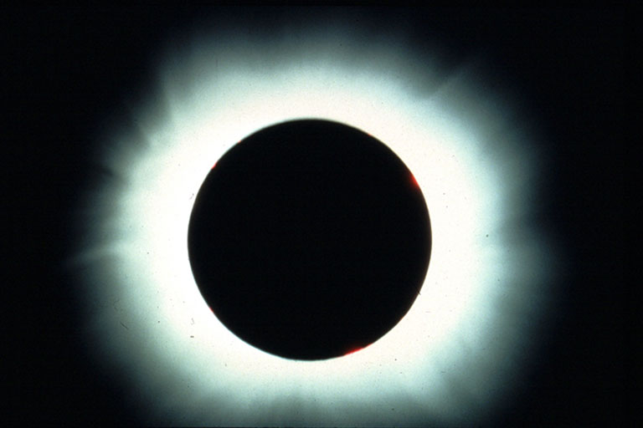
Solar Eclipse

Slide 5
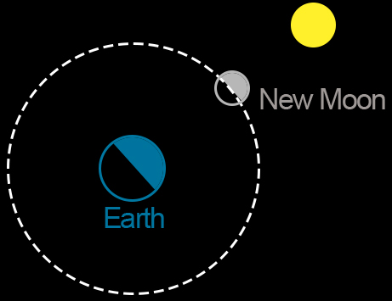
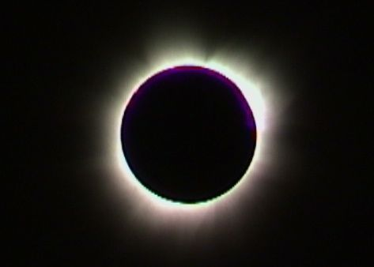
Solar Eclipse
Solar Eclipses can only occur during a New Moon Phase
This Photo by Unknown Author is licensed under CC BY-NC
This Photo by Unknown Author is licensed under CC BY-SA

Slide 6
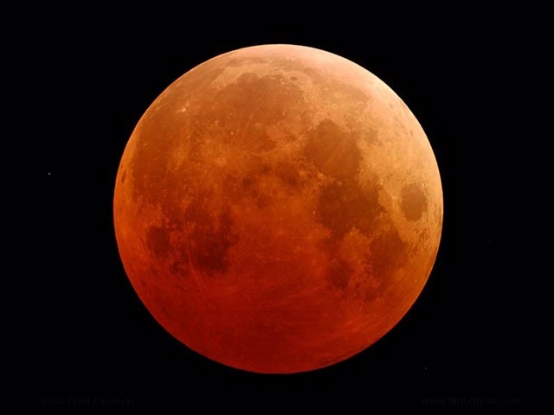
Lunar Eclipses

Slide 7
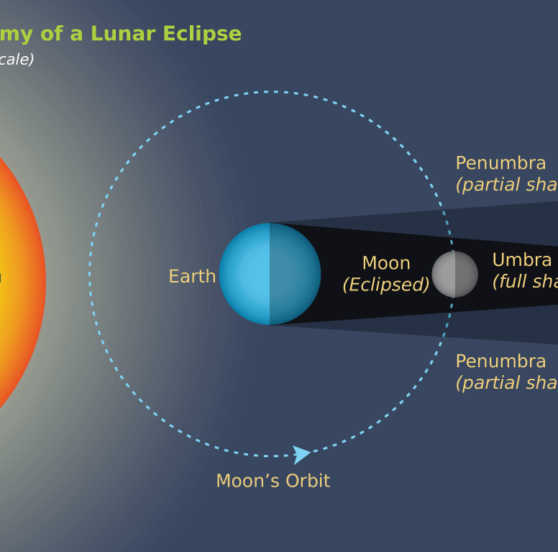
Lunar Eclipses
Lunar Eclipses can only occur during a Full Moon phase
This Photo by Unknown Author is licensed under CC BY-SA-NC

Slide 8
Total Eclipse versus Partial Eclipse
Darkest part of shadow is cone-shaped shadow, & called the Umbra. Only people in the Umbra experience a total eclipse.
A larger part of the shadow is less dark, and is called the Penumbra. In the penumbra, part of the sun is still visible.
You are much more likely to see a total lunar eclipse than a total solar eclipse because a total lunar eclipse can be seen from anywhere on Earth

Slide 9
Umbra and Penumbra
This Photo by Unknown Author is licensed under CC BY-SA

Slide 10
Umbra and Penumbra – Solar Eclipse
This Photo by Unknown Author is licensed under CC BY-SA

Slide 11
Umbra and Penumbra – Lunar Eclipse
This Photo by Unknown Author is licensed under CC BY-NC-ND

Slide 12
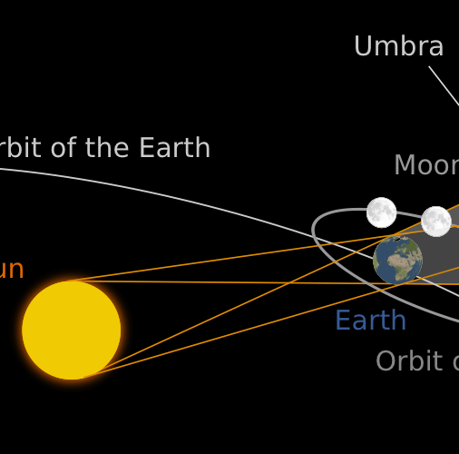
Why Don’t We Have An Eclipse Every Month?
The moon’s orbit is not on the same plane as the Earth’s orbit (they are not at the same level.)
The moon’s orbit is tilted about 5 degrees from Earth’s orbit so eclipses only occur when the Sun, Moon and Earth happen to line up.
This Photo by Unknown Author is licensed under CC BY

